Slide 1
Passwords Lab

Slide 2
Passwords Lab
Description of the lab
Materials needed
Kali Linux Machine
Software Tools used
Leafpad

Slide 3
Objectives Covered
Security+ Objectives (SY0-701)
Objective 2.5 - Explain the purpose of mitigation techniques used to secure the enterprise..
Hardening Techniques
Password Policies

Slide 4
The Password Lab
Setup Environment
Navigate to Shadow
Exploring the Kali Password
Creating a User
Creating a Password
Moving the Password
Testing the Password
On Your Own Activity

Slide 5
Setup Environment
Log into your range
Open the Kali Linux Environment
You should be on your Kali Linux Desktop
Open the Terminal

Slide 6

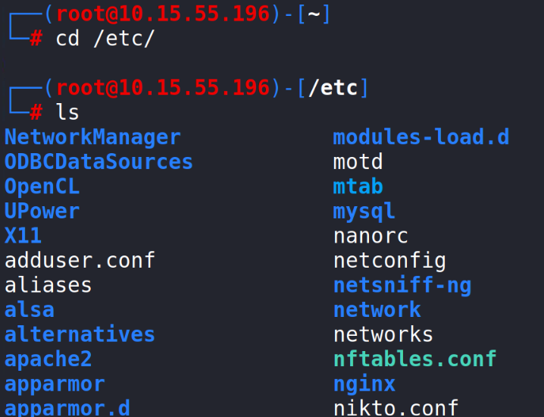
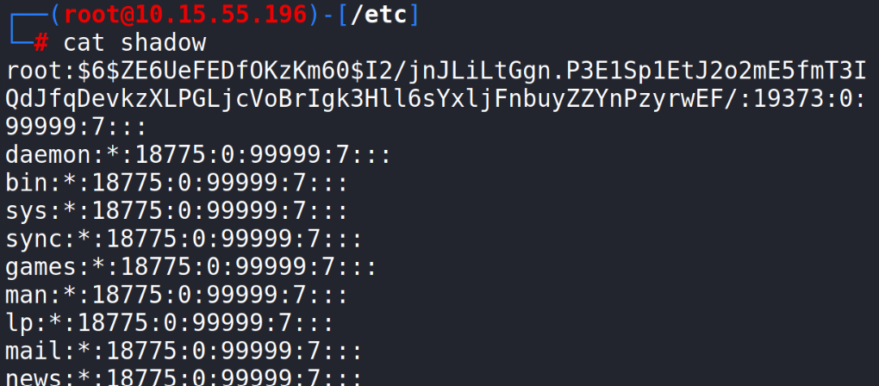
Navigate to Shadow
Make yourself the root user:
sudo su -
Change directory to the etc folder:
cd /etc/
Display all the directories within /etc:
ls
You should be able to see the shadow file
Read the Shadow file where the passwords are stored:
cat shadow
Notice that the users root and kali have passwords stored

Slide 7
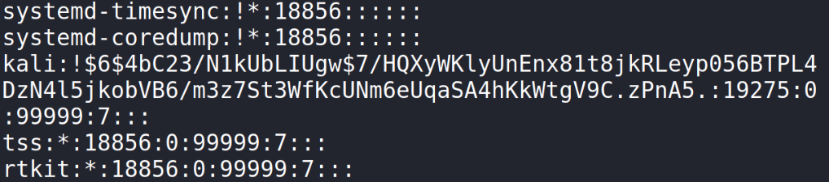
Exploring the Kali Password
Take a look at the kali password*
Remember, “password” is the password*
What does all this mean?
*Please Note: The username/password combination can differ depending on the range/environment you are using

Slide 8
Exploring the Kali Password
Take a look at the kali password
Remember, “password” is the password
The user’s name

Slide 9
Exploring the Kali Password
Take a look at the kali password
Remember, “password” is the password
The Hash Algorithm
(Here it is 6, thus using SHA-512 Algorithm)
$1$ → MD5
$2$ → Blowfish
$2a$ → ekaBlowfish
$5$ → SHA-256
$6$ → SHA-512

Slide 10
Exploring the Kali Password
Take a look at the kali password
Remember, “password” is the password
The Salt
What is the purpose of a salt? Why is this important for security?

Slide 11
Exploring the Kali Password
Take a look at the kali password
Remember, “password” is the password
The Hashed Password
What is a hashed password and why are passwords stored like this?

Slide 12
Exploring the Kali Password
Thus, passwords are stored in the following format:
username: $hash number$salt$hashed password:
Kali has the following data:
username = kali
Hash Algorithm = 6 or SHA-512
Salt is ‘4bC23/N1kUbLIUgw’ (Note: COPY and SAVE this for LATER)
Hash is ‘7/HQXyWKlyUnEnx81t8jkRLeyp056BTPL4DzN4l5jkobVB6/m3z7St3WfKcUNm6eUqaSA4hKkWtgV9C.zPnA5.’
Plaintext password is ‘password’

Slide 13
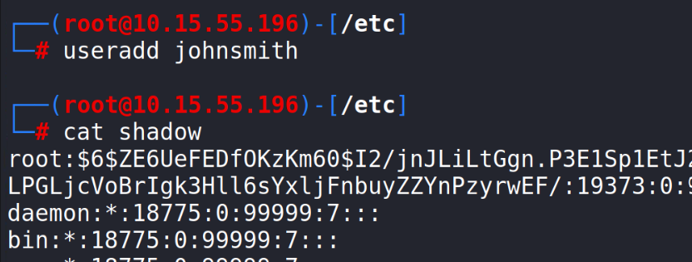
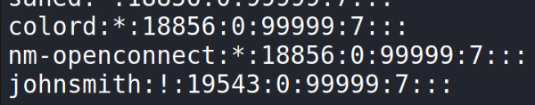
Creating a User
Create a new user with the same hash and password as ‘kali’
Create a new user:
useradd johnsmith
Now, check out johnsmith’s data:
cat shadow
Notice, that johnsmith has a “!” where the password should be stored
No stored password

Slide 14
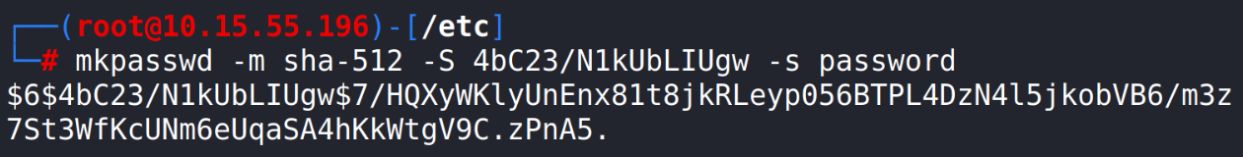
Creating a Password
Use the following command to make the same password as the kali account:
mkpasswd -m sha-512 -S <YOUR SALT> -s password
Method SHA-512
Salt is 4bC23/N1kUbLIUgw
Password is password
(-s stands for standard input)
Make password
Notice, the password created is the same as the original user

Slide 15
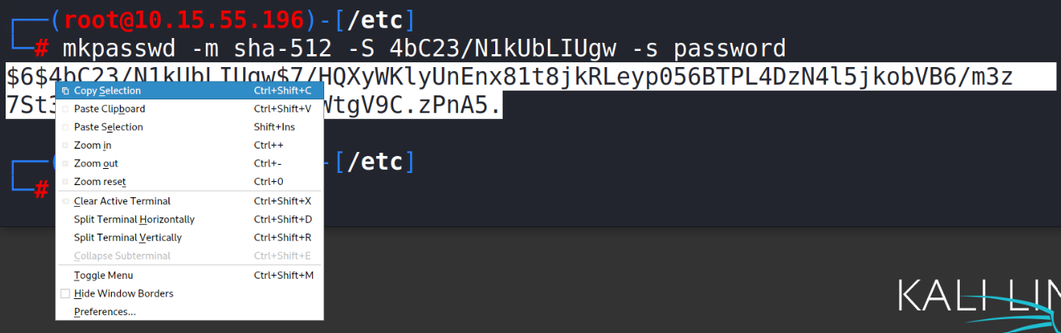
Moving the Password
Highlight the entire password
Right-click, and select “copy selection”
Open shadow in Leafpad:
leafpad shadow
Navigate to user johnsmith
Delete the exclamation mark
Paste in the password
Save and exit Leafpad!
Only replace the ‘!’
Please Note: If Leafpad is not able to open the display while logged in as the root user, use the following command to open the text in the nano editor:
nano shadow

Slide 16
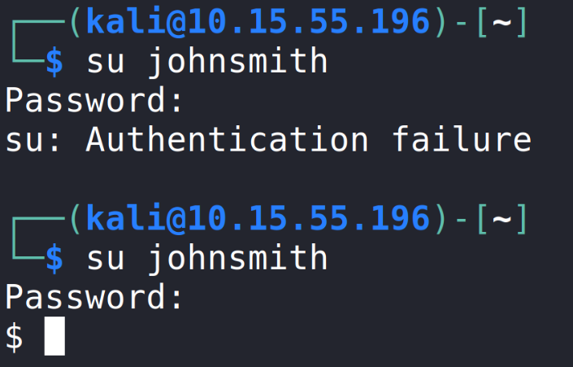
Test the password
Open a new Terminal (should not be root access)
Switch user to johnsmith:
su johnsmith
When prompted, enter the wrong password
Do NOT type in ‘password’
You should see “Authentication failure”
Switch user to johnsmith:
su johnsmith
Now type in ‘password’ as the password
You should notice that it gave you access to johnsmith account!

Slide 17
On Your Own Activity
Try and make passwords for the following:
Create your own SHA-512 password with a different salt
A different password using MD5 Algorithm (-m md5)
Another password using SHA-256 Algorithm (-m SHA-256)
Here was the command we used to create the kali password:
mkpasswd -m sha-512 -S 4bC23/N1kUbLIUgw -s password
Remember to check to make sure the password works!

